Slide 1
Chapter 3
The Greedy Method
3 -<number>

Slide 2
A simple example
Problem: Pick k numbers out of n numbers such that the sum of these k numbers is the largest.
Algorithm:
    FOR i = 1 to k
    pick out the largest number and
    delete this number from the input.
    ENDFOR
3 -<number>

Slide 3
The greedy method
Suppose that a problem can be solved by a sequence of decisions. The greedy method has that each decision is locally optimal. These locally optimal solutions will finally add up to a globally optimal solution.
<戰國策.秦策>范睢對秦昭襄王說：「王不如遠交而近攻，得寸，王之寸；得尺，亦王之尺也。」
Only a few optimization problems can be solved by the greedy method.
3 -<number>

Slide 4
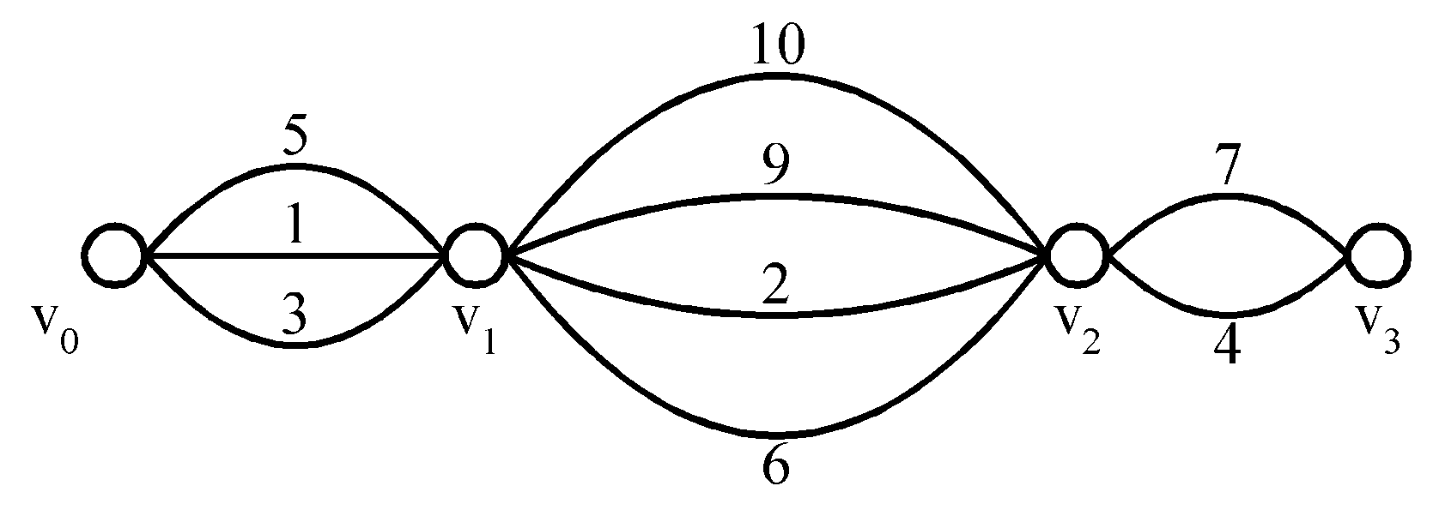
Shortest paths on a special graph
Problem: Find a shortest path from v₀ to v₃.
The greedy method can solve this problem.
The shortest path: 1 + 2 + 4 = 7.
3 -<number>

Slide 5
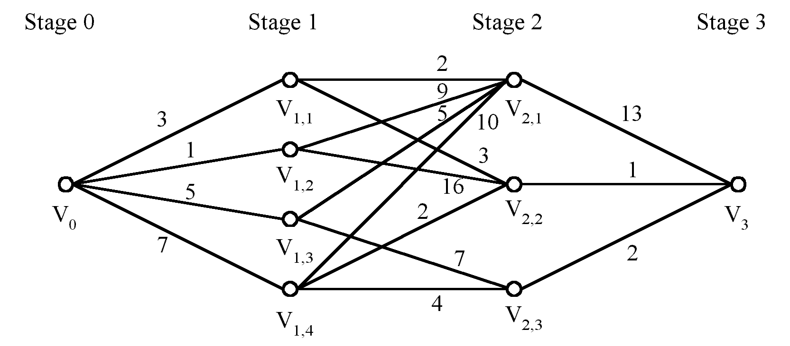
Shortest paths on a multi-stage graph
Problem: Find a shortest path from v₀ to v₃ in the multi-stage graph.
Greedy method: v₀v_{1,2}v_{2,1}v₃ = 23
Optimal: v₀v_{1,1}v_{2,2}v₃ = 7
The greedy method does not work.
3 -<number>

Slide 6
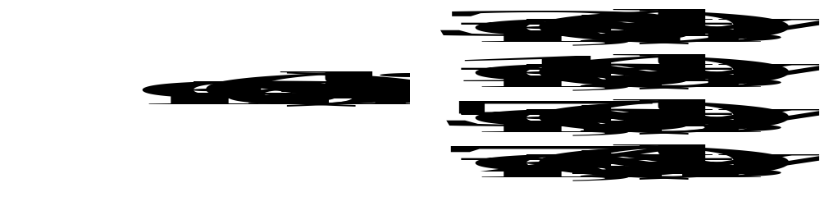
Solution of the above problem
d_{min}(i,j): minimum distance between i and j.
This problem can be solved by the dynamic programming method.
3 -<number>

Slide 7
Minimum spanning trees (MST)
It may be defined on Euclidean space points or on a graph.
G = (V, E): weighted connected undirected graph
Spanning tree : S = (V, T), T ⊆ E, undirected tree
Minimum spanning tree(MST) : a spanning tree with the smallest total weight.
3 -<number>

Slide 8
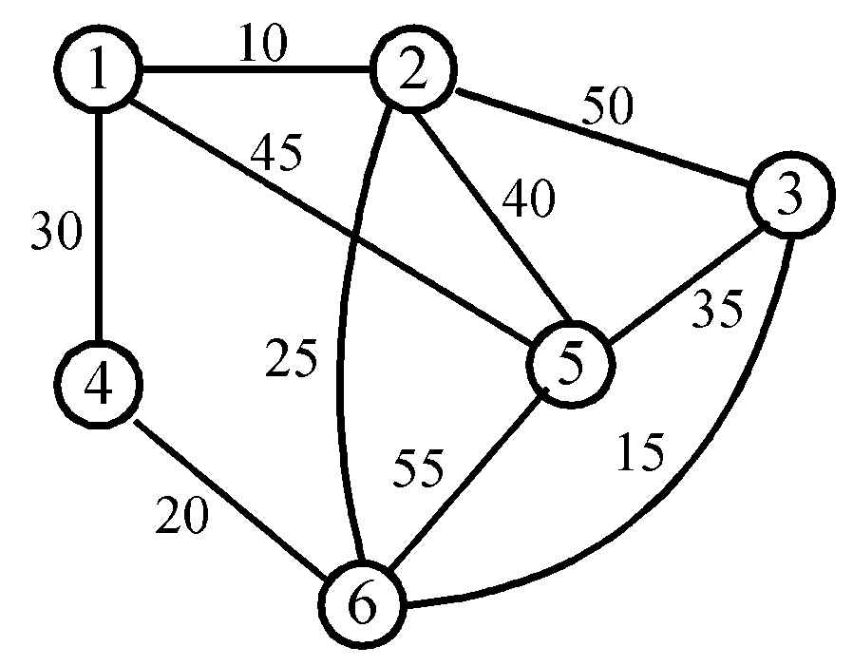
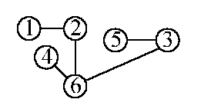
An example of MST
A graph and one of its minimum costs spanning tree
3 -<number>

Slide 9
Kruskal’s algorithm for finding MST
Step 1: Sort all edges into nondecreasing order.
Step 2: Add the next smallest weight edge to the forest if it will not cause a cycle.
Step 3: Stop if n-1 edges. Otherwise, go to Step2.
3 -<number>

Slide 10
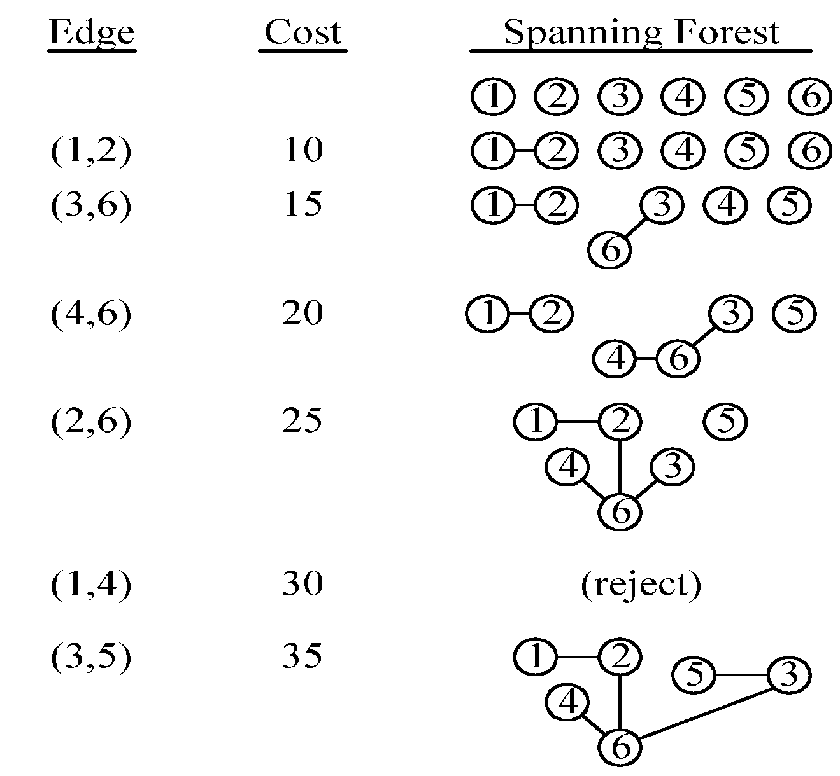
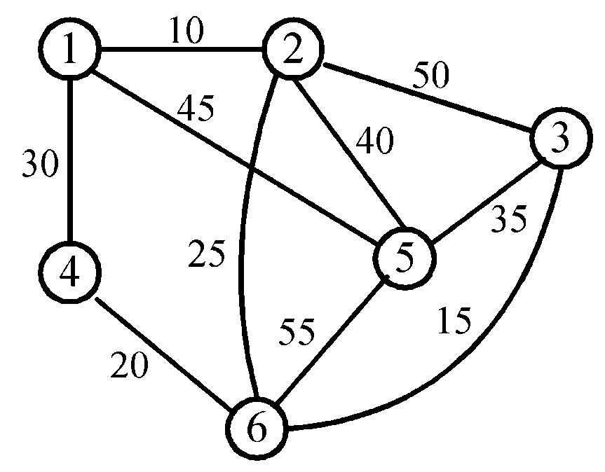
An example of Kruskal’s algorithm
3 -<number>

Slide 11
The details for constructing MST
How do we check if a cycle is formed when a new edge is added?
  By the SET and UNION method.
Each tree in the spanning forest is represented by a SET.
  If (u, v) ∈ E and u, v are in the same set, then the addition of (u, v) will form a cycle.
  If (u, v) ∈ E and u∈S₁ , v∈S₂ , then perform UNION of S₁ and S₂ .
3 -<number>

Slide 12

Time complexity
Time complexity: O(|E| log|E|)
  Step 1: O(|E| log|E|)
  Step 2 & Step 3:
  Where α is the inverse of Ackermann’s function.
3 -<number>

Slide 13
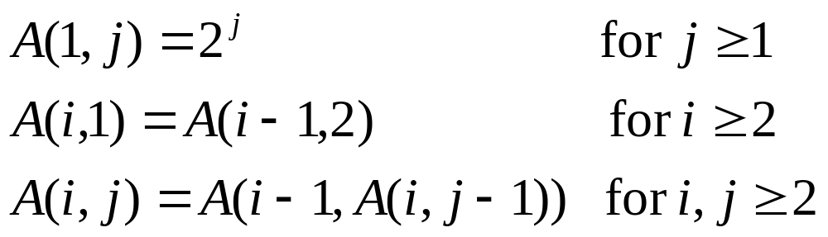
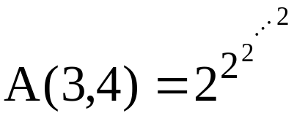

Ackermann’s function
⇒ A(p, q+1) > A(p, q), A(p+1, q) > A(p, q)
65536 two’s
3 -<number>

Slide 14
Inverse of Ackermann’s function
α(m, n) = min{i≥1|A(i, ⎣m/n⎦) > log₂n}
Practically, A(3,4) > log₂n
⇒α(m, n) ≤ 3
⇒α(m, n) is almost a constant.
3 -<number>

Slide 15
Prim’s algorithm for finding MST
Step 1: x ∈ V, Let A = {x}, B = V - {x}.
Step 2: Select (u, v) ∈ E, u ∈ A, v ∈ B such that (u, v) has the smallest weight between A and B.
Step 3: Put (u, v) in the tree. A = A ∪ {v}, B = B - {v}
Step 4: If B = ∅, stop; otherwise, go to Step 2.
Time complexity : O(n²), n = |V|.
(see the example on the next page)
3 -<number>

Slide 16
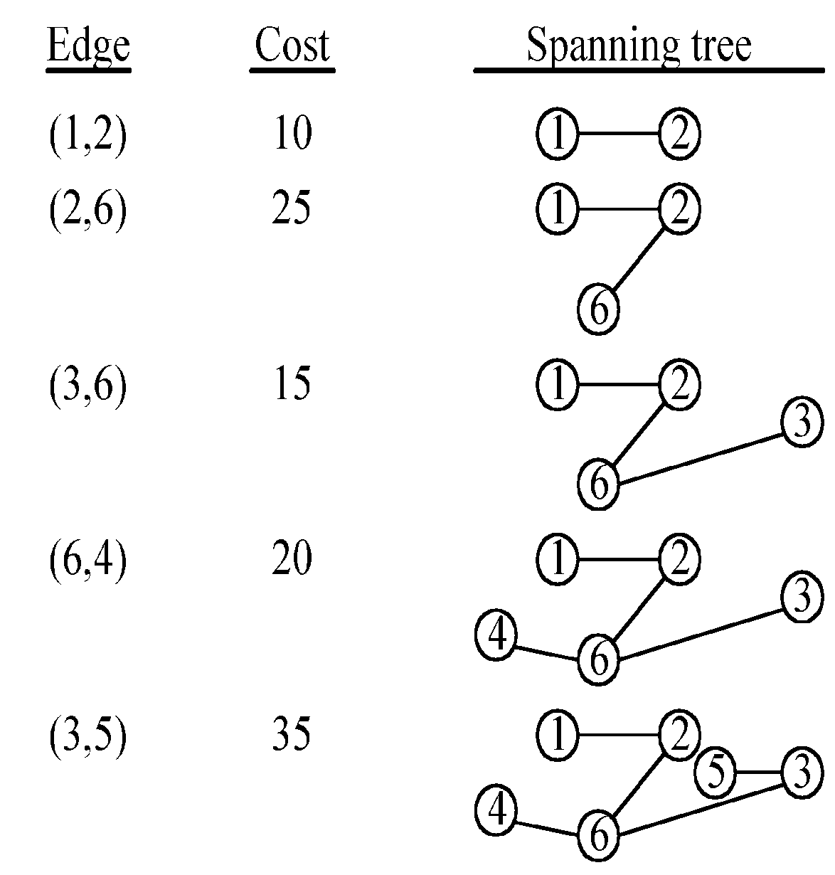
An example for Prim’s algorithm
3 -<number>

Slide 17
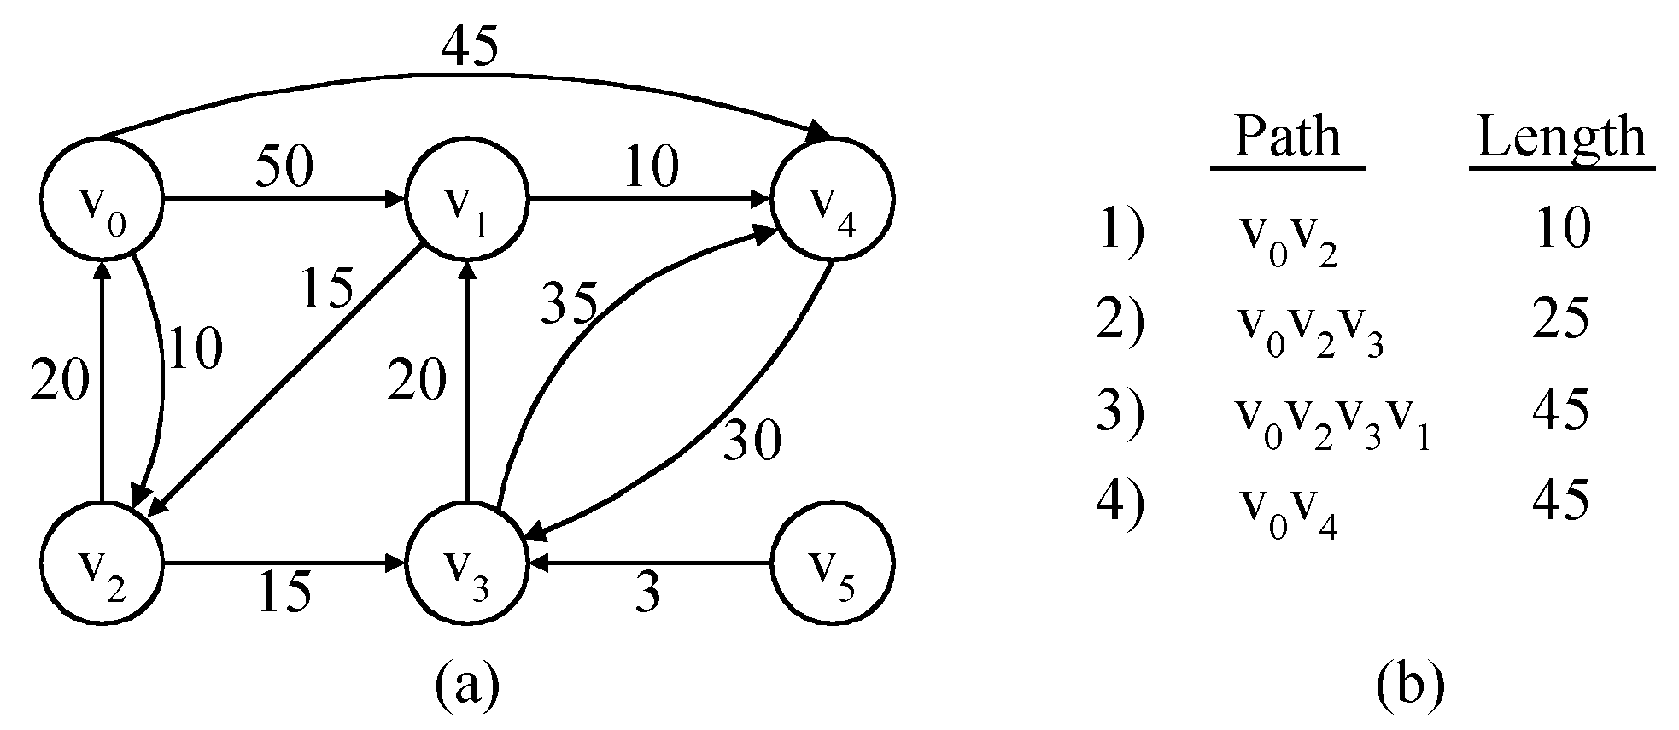
The single-source shortest path problem
shortest paths from v₀ to all destinations
3 -<number>

Slide 18
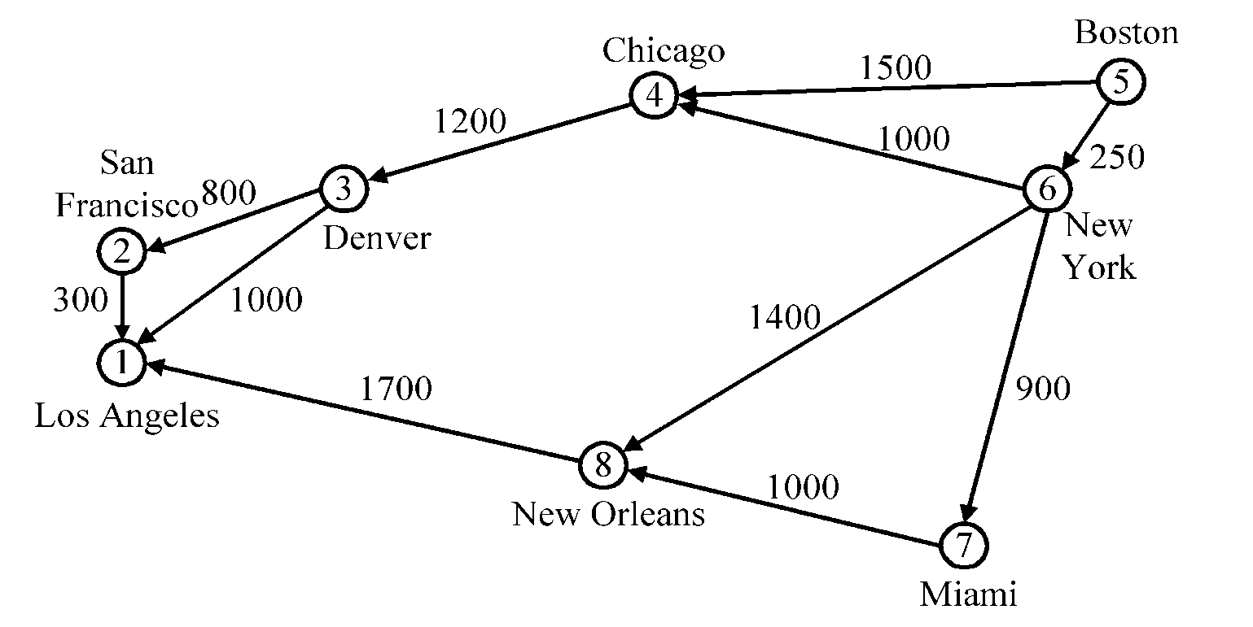
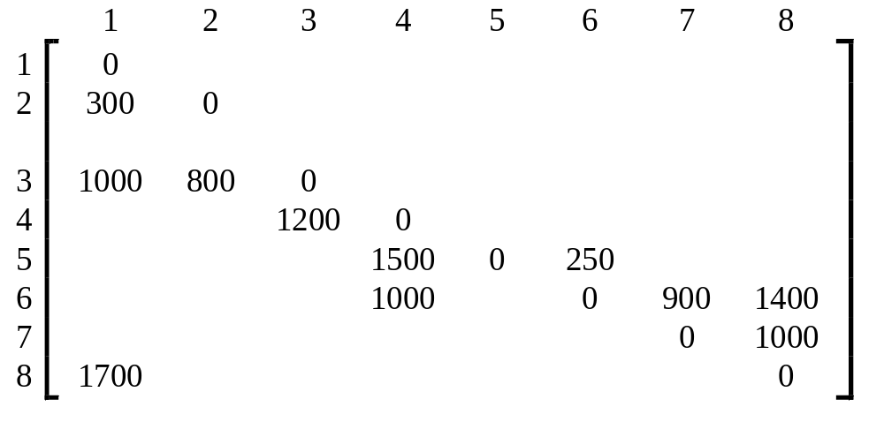
Dijkstra’s algorithm
In the cost adjacency matrix, all entries not shown are +∞.
3 -<number>

Slide 19
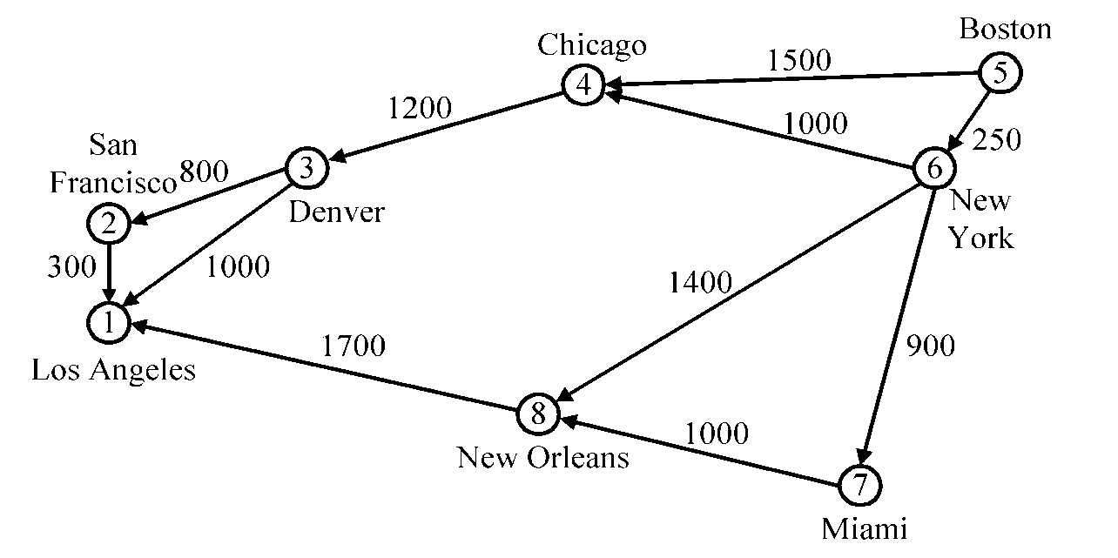
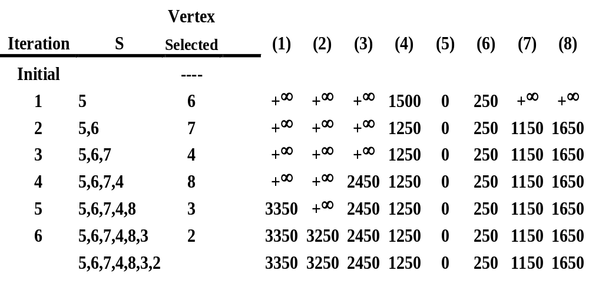
Time complexity : O(n²), n = |V|.
3 -<number>

Slide 20
The longest path problem
Can we use Dijkstra’s algorithm to find the longest path from a starting vertex to an ending vertex in an acyclic directed graph?
There are 3 possible ways to apply Dijkstra’s algorithm:
  Directly use “max” operations instead of “min” operations.
  Convert all positive weights to be negative. Then find the shortest path.
  Give a very large positive number M. If the weight of an edge is w, now M-w is used to replace w. Then find the shortest path.
All these 3 possible ways would not work!
3 -<number>

Slide 21
CPM for the longest path problem
The longest path(critical path) problem can be solved by the critical path method(CPM) :
Step 1:Find a topological ordering.
Step 2: Find the critical path.
(see [Horiwitz 1995].)
  [[Horowitz 1995] E. Howowitz, S. Sahni and D. Metha, Fundamentals of Data Structures in C++, Computer Science Press, New York, 1995
3 -<number>

Slide 22
The 2-way merging problem
# of comparisons required for the linear 2-way merge algorithm is m₁+ m₂ -1 where m₁ and m₂ are the lengths of the two sorted lists respectively.
  2-way merging example
2 3 5 6
1 4 7 8
The problem: There are n sorted lists, each of length m_{i}. What is the optimal sequence of merging process to merge these n lists into one sorted list ?
3 -<number>

Slide 23
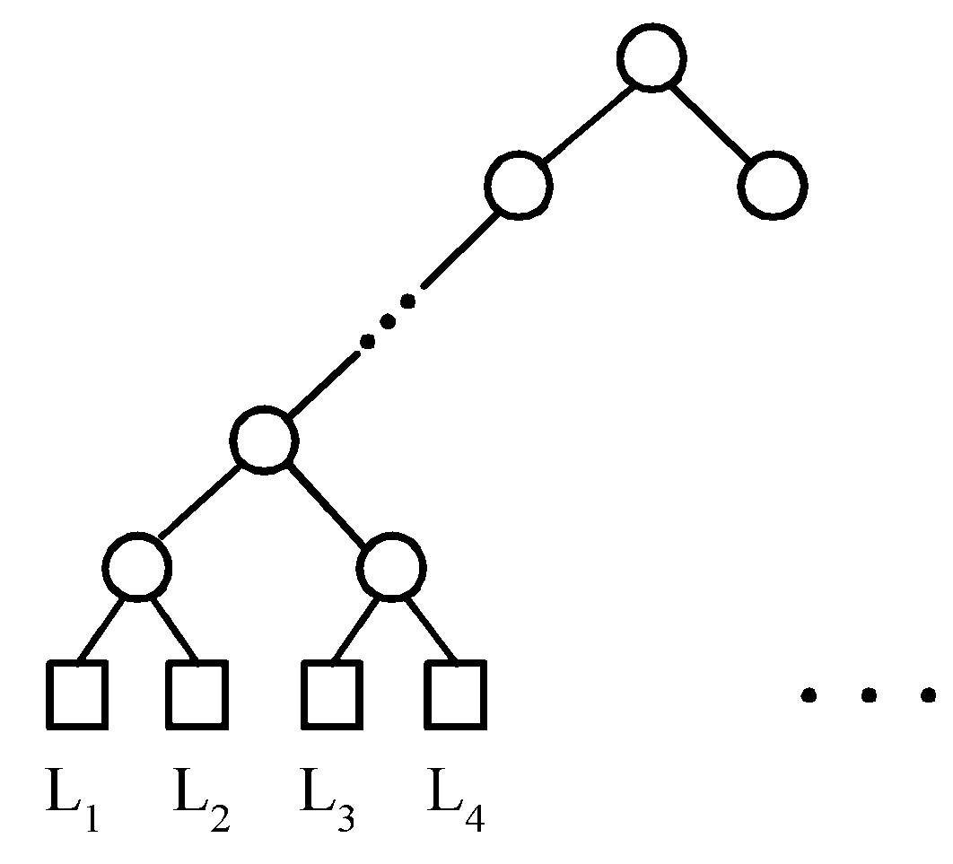
Extended binary trees
An extended binary tree representing a 2-way merge
3 -<number>

Slide 24
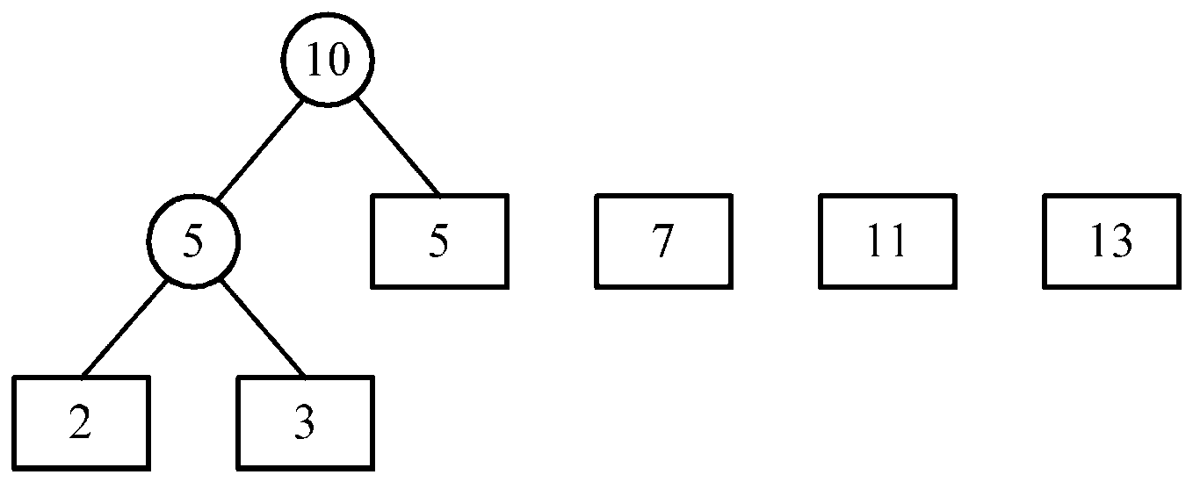
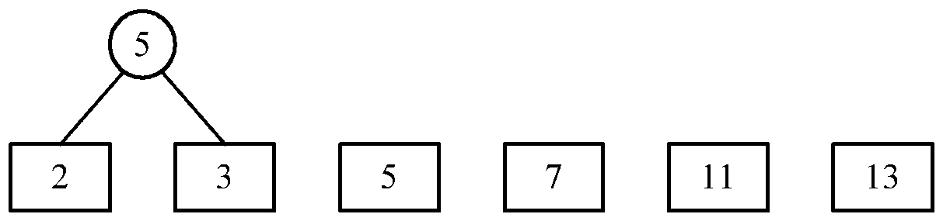
An example of 2-way merging
Example: 6 sorted lists with lengths 2, 3, 5, 7, 11 and 13.
3 -<number>

Slide 25
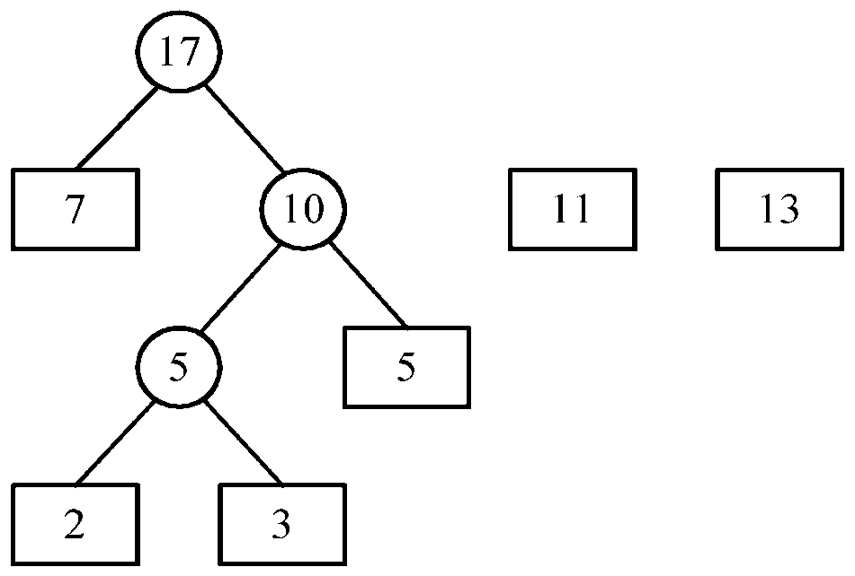
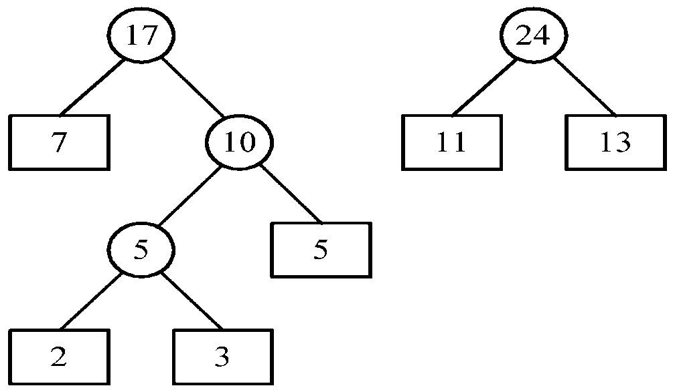
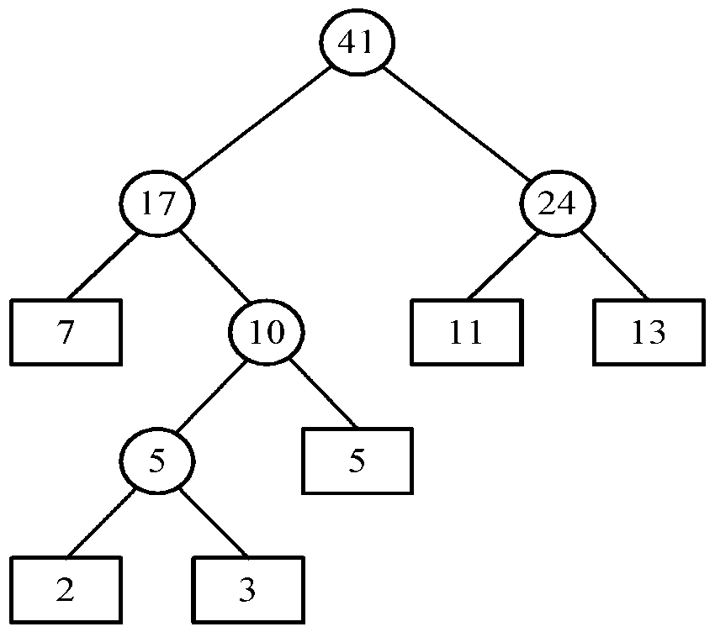
Time complexity for generating an optimal extended binary tree:O(n log n)
3 -<number>

Slide 26
Huffman codes
In telecommunication, how do we represent a set of messages, each with an access frequency, by a sequence of 0’s and 1’s?
To minimize the transmission and decoding costs, we may use short strings to represent more frequently used messages.
This problem can by solved by using an extended binary tree which is used in the 2-way merging problem.
3 -<number>

Slide 27
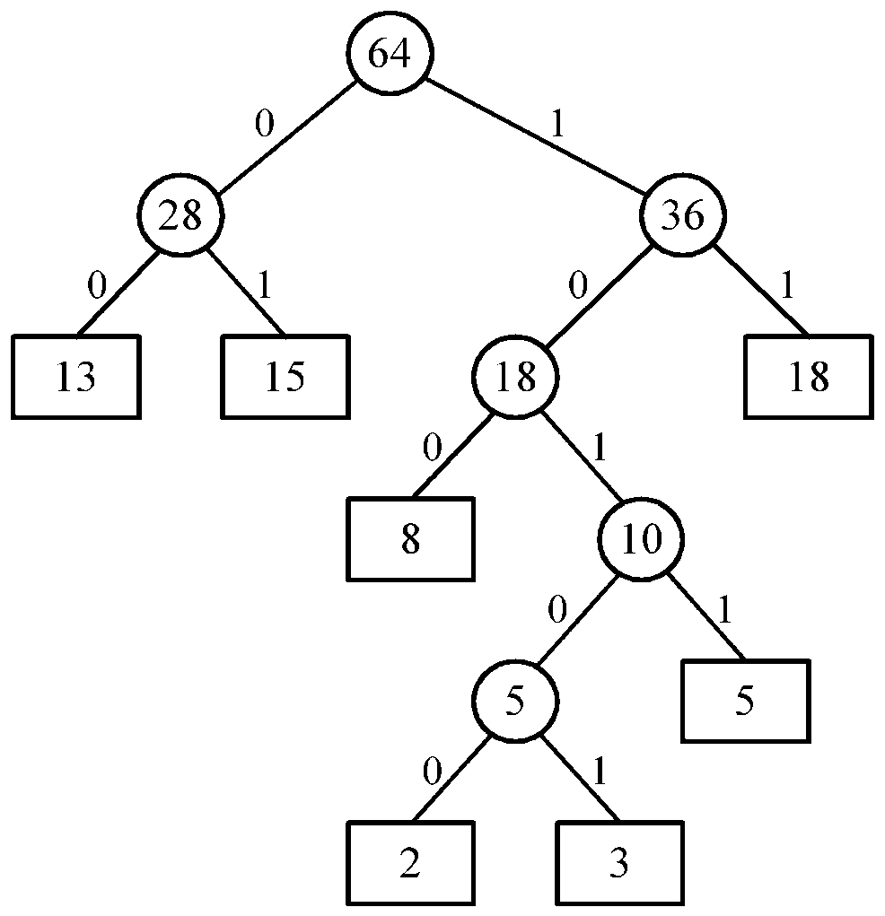
An example of Huffman algorithm
Symbols: A, B, C, D, E, F, G
freq. : 2, 3, 5, 8, 13, 15, 18
Huffman codes:
A: 10100 B: 10101 C: 1011
D: 100 E: 00 F: 01
G: 11
A Huffman code Tree
3 -<number>

Slide 28
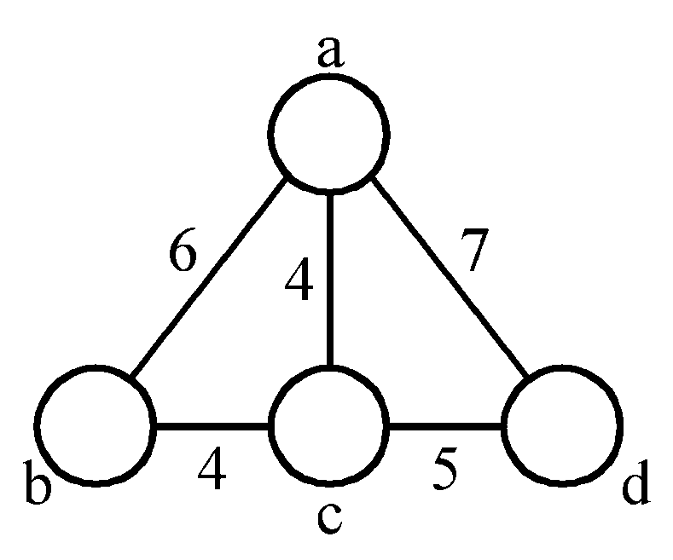
The minimal cycle basis problem
3 cycles:
A₁ = {ab, bc, ca}
A₂ = {ac, cd, da}
A₃ = {ab, bc, cd, da}
where A₃ = A₁ ⊕ A₂
(A ⊕ B = (A∪B)-(A∩B))
A₂ = A₁ ⊕ A₃
A₁ = A₂ ⊕ A₃
Cycle basis : {A₁, A₂} or {A₁, A₃} or {A₂, A₃}
3 -<number>

Slide 29
Def : A cycle basis of a graph is a set of cycles such that every cycle in the graph can be generated by applying ⊕ on some cycles of this basis.
Minimal cycle basis : smallest total weight of all edges in this cycle.
e.g. {A₁, A₂}
3 -<number>

Slide 30
Algorithm for finding a minimal cycle basis:
  Step 1: Determine the size of the minimal cycle basis, demoted as k.
  Step 2: Find all of the cycles. Sort all cycles( by weight).
  Step 3: Add cycles to the cycle basis one by one. Check if the added cycle is a linear combination of some cycles already existing in the basis. If it is, delete this cycle.
  Step 4: Stop if the cycle basis has k cycles.
3 -<number>

Slide 31
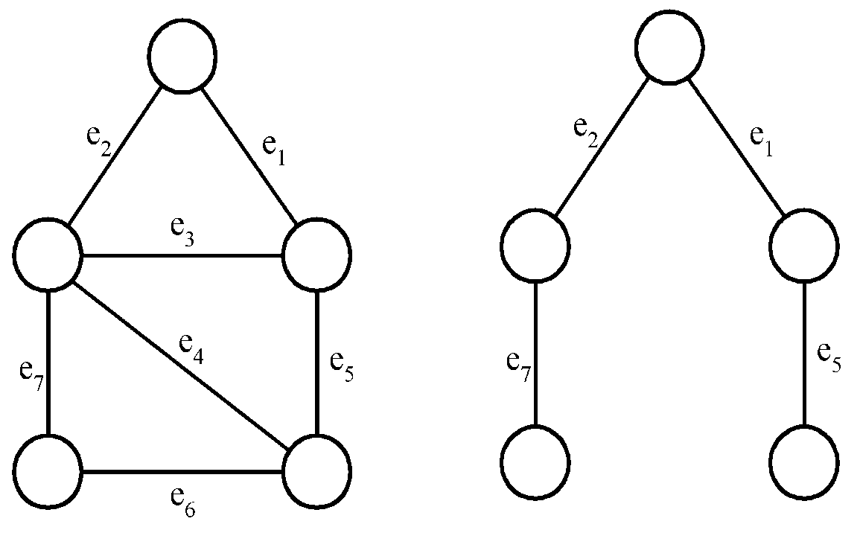
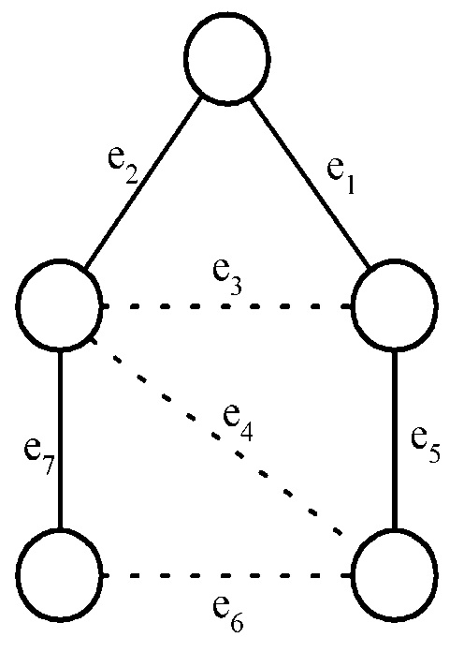
Detailed steps for the minimal cycle basis problem
Step 1 :
A cycle basis corresponds to the fundamental set of cycles with respect to a spanning tree.
a graph
a spanning tree
a fundamental set of cycles
# of cycles in a cycle basis :
= k
= |E| - (|V|- 1)
= |E| - |V| + 1
3 -<number>

Slide 32
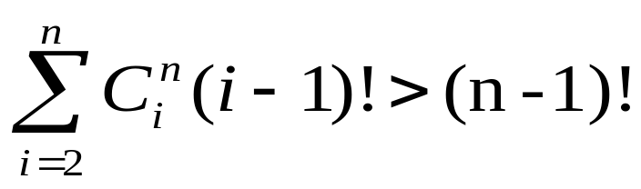
Step 2:
How to find all cycles in a graph?
[Reingold, Nievergelt and Deo 1977]
How many cycles in a graph in the worst case?
In a complete digraph of n vertices and n(n-1) edges:
Step 3:
  How to check if a cycle is a linear combination of some cycles?
  Using Gaussian elimination.
3 -<number>

Slide 33
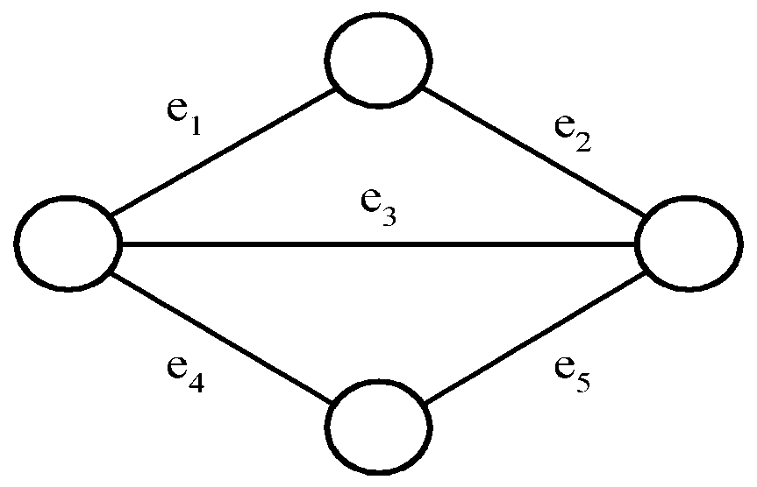
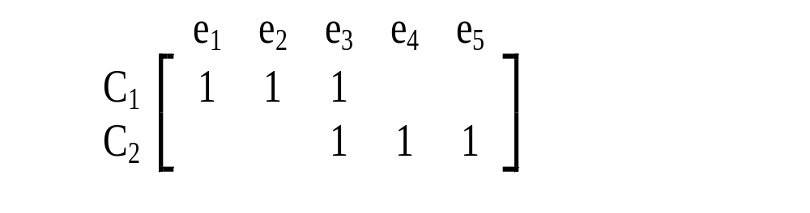
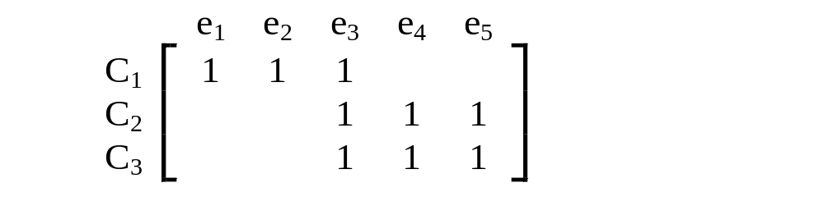
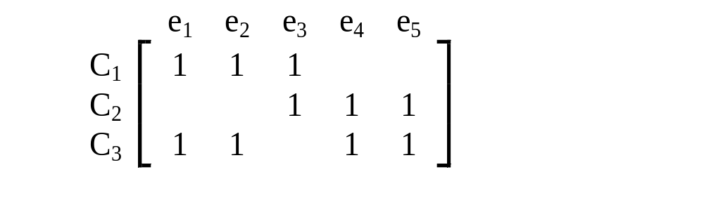
Gaussian elimination
2 cycles C₁ and C₂ are represented by a 0/1 matrix
E.g.
⊕ on rows 1 and 3
Add C₃
on rows 2 and 3 : empty
∵C₃ = C₁ ⊕ C₂
3 -<number>

Slide 34
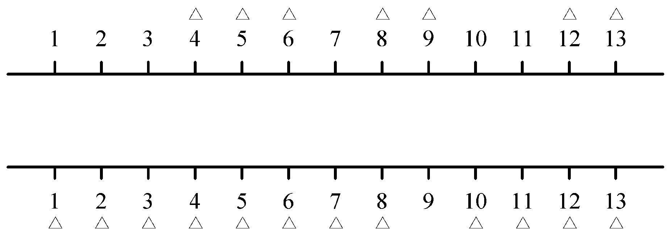
The 2-terminal one to any special channel routing problem
Def: Given two sets of terminals on the upper and lower rows, respectively, we have to connect each upper terminal to the lower row in a one to one fashion. This connection requires that # of tracks used is minimized.
3 -<number>

Slide 35

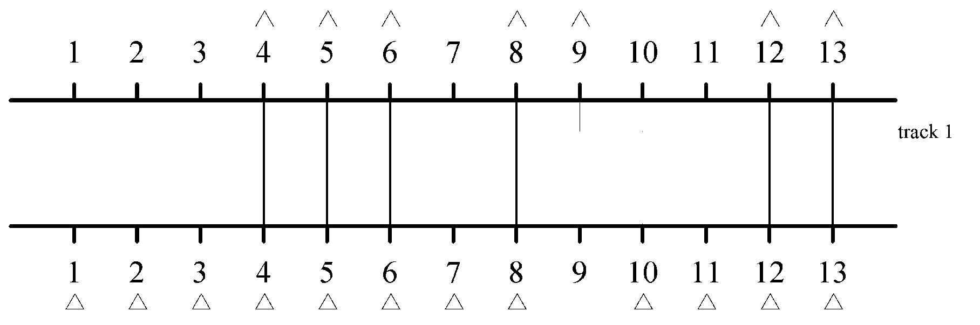
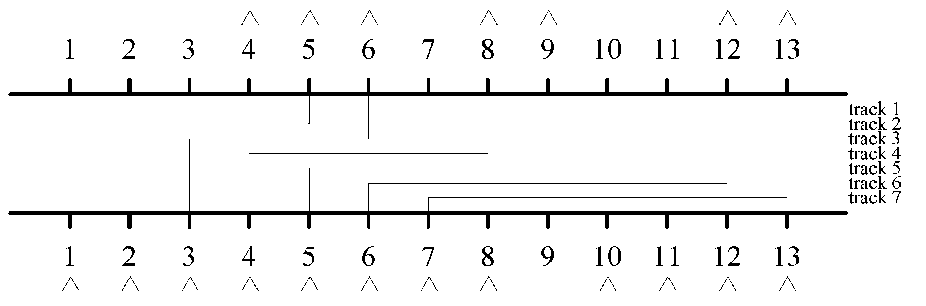
2 feasible solutions
3 -<number>

Slide 36
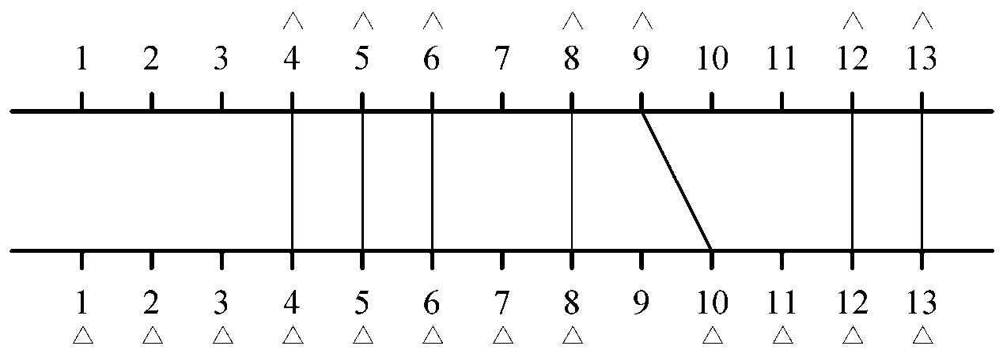
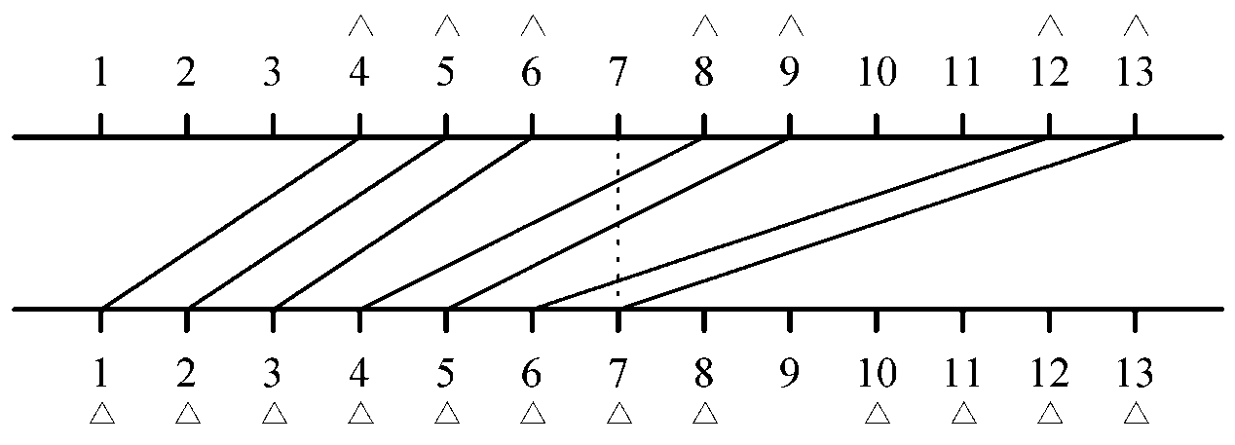
Redrawing solutions
(a) Optimal solution
(b) Another solution
3 -<number>

Slide 37
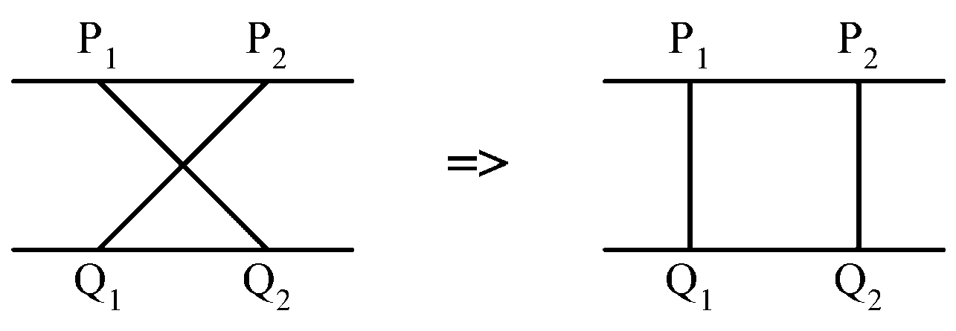
At each point, the local density of the solution is # of lines the vertical line intersects.
The problem: to minimize the density. The density is a lower bound of # of tracks.
Upper row terminals: P₁ ,P₂ ,…, P_{n} from left to right
Lower row terminals: Q₁ ,Q₂ ,…, Q_{m} from left to right m > n.
It would never have a crossing connection:
3 -<number>

Slide 38
Suppose that we have a method to determine the minimum density, d, of a problem instance.
The greedy algorithm:
Step 1 : P₁ is connected Q₁.
Step 2 : After P_{i} is connected to Q_{j}, we check whether P_{i+1} can be connected to Q_{j+1}. If the density is increased to d+1, try to connect P_{i+1} to Q_{j+2}.
Step 3 : Repeat Step2 until all P_{i}’s are connected.
3 -<number>

Slide 39
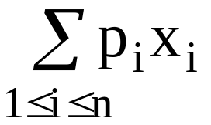
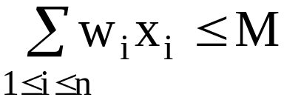
The knapsack problem
n objects, each with a weight w_{i} > 0
a profit p_{i} > 0
capacity of knapsack: M
Maximize
Subject to
0 ≤ x_{i} ≤ 1, 1 ≤ i ≤ n
3 -<number>

Slide 40
The knapsack algorithm
The greedy algorithm:
Step 1: Sort p_{i}/w_{i} into nonincreasing order.
Step 2: Put the objects into the knapsack according
to the sorted sequence as possible as we can.
e. g.
  n = 3, M = 20, (p₁, p₂, p₃) = (25, 24, 15)
  (w₁, w₂, w₃) = (18, 15, 10)
  Sol: p₁/w₁ = 25/18 = 1.39
  p₂/w₂ = 24/15 = 1.6
  p₃/w₃ = 15/10 = 1.5
  Optimal solution: x₁ = 0, x₂ = 1, x₃ = 1/2
3 -<number>

